Slide 1
A Deep Neural Network for Network Intrusion Detection
Name: Yash Patel
Guide: Dr. Radhika

Slide 2
Abstract
This paper talks about a problem: attacks on computer networks are a big issue in today's world, affecting everything from small devices to large cloud platforms that we use every day. As more people use networks, these attacks become more frequent and sophisticated. Detecting and stopping these attacks is crucial but challenging.

Slide 3
Problem with existing solutions
Unlike traditional methods that rely on predefined patterns of attacks (like a signature), machine learning can adapt and learn from new types of attacks. However, existing machine learning solutions often have a problem – they may detect too many false alarms, mistakenly thinking there's an attack when there isn't.

Slide 4
Paper Approch
To address this issue, the paper introduces a new neural network called LuNet, which combines two types of neural networks: convolutional neural network (CNN) and recurrent neural network (RNN). These networks work together to analyze network traffic data, considering both the spatial and temporal aspects (where things are and how they change over time).

Slide 5
Why they use CNN and RNN both together
CNN: This term involves a specific way of processing information, especially useful for recognizing patterns in things like images.
RNN: "Recurrent Neural Network" is a type of system that's good at understanding and learning from sequences of information, where the order matters.

Slide 6
How Lunet works:
The paper suggests that by combining the strengths of CNN (good at spatial features, like shapes) and RNN (good at temporal features, like changes over time), LuNet is able to effectively capture both spatial and temporal aspects of the data.
This type of structure is also called as Hierarchical Convolutional and Recurrent Neural Network (HAST-IDS)

Slide 7
Some other smart techniques for NID
SVM(Support Vector Machines):
It's like a pair of glasses that can make data, which is messy and mixed up, easier to understand.
Adaptive Boosting and Random Forest :
They're like teams of experts that work together to understand data better.

Slide 8
Limitations of Kernel Machines and Ensemble Classifiers
Not Scalable to Large Data Sets
Validation Accuracy Doesn't Keep Up
Learning Limited to Specified Features

Slide 9
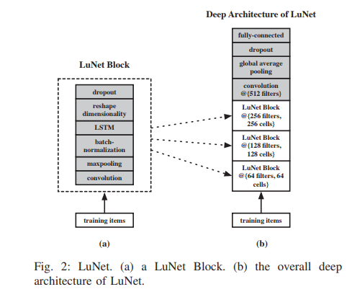
Architecture of the LUNET

Slide 10
Datasets used for the LUNET
LuNet's evaluation is done using two specific datasets, NSL-KDD and UNSW-NB15, which are chosen because they are non-redundant and provide reliable results for assessing LuNet's performance in detecting network intrusions.
NSL-KDD Dataset :
set of data created by the Canadian Institute for Cyber Security (CICS).
There are 39 types of attacks, and they fall into four main groups: Denial of Service (DoS), User to Root (U2R), Remote to Local (R2L), and Probe.
UNSW-NB15 Dataset:
The UNSW-NB15 dataset was made by the Australian Center for Cyber Security (ACCS) in 2015.
The dataset includes nine categories of attacks: Denial of Service (DoS), Exploits, Generic attacks, Shellcode attacks, Reconnaissance, Backdoor attacks, Worms, Analysis, and Fuzzers.

Slide 11
Progress report
Understanding the research paper indepth.
Learned Python libraries numpy , pandas and matplotlib.
Learned Linear regression in machine learning.
Brush up the concepts of deep learning like activation functions, CNN, RNN etc.
Currently learning logistic regression algorithm of the machine learning

Slide 12
Thank You

